Slide 1
Transfer Admission Guarantee (TAG)
What you need to know for Fall 2021 TAG admission

Slide 2
How to pull up your transcript
MyCOM portal -->
Students--> (on the right side)
Records -->
Unofficial Transcript

Slide 3
The Nuts and Bolts of TAG
WHAT IS TAG:
TAG is guaranteed admission to one of six UC campuses based on specific criteria such as GPA, major preparation, etc.
You can apply for TAG at one campus; you can apply to all UC campuses during the regular UC application cycle.
DEADLINES:
TAG applications are due Sept. 30th
You still NEED to fill out a UC application during the regular application cycle (Nov. 1-30).

Slide 4
What schools participate in TAG?
UC Davis
UC Irvine
UC Merced
UC Riverside
UC Santa Barbara
UC Santa Cruz

Slide 5
What schools DO NOT participate in TAG?
UC Berkeley
UC Los Angeles
UC San Diego

Slide 6
Who is NOT eligible for TAG?
Already earned a BA or above
Previously enrolled at UC during regular term (not including summer session only) and plan to return to the same campus
Students concurrently enrolled in HS at the time of TAG application submission

Slide 7
Steps to Complete TAG & UC Admission
STEP 1: Research
STEP 2: TAG​
STEP 3: Fill out app
STEP 4: Submit
Identify the campus where you plan to submit a TAG
Review the requirements for specific school and major designated on the TAG agreement
Meet with a counselor to create an education plan based on TAG requirements
Complete the Transfer Admissions Planner (TAP) and the online UC TAG application
Meet with a counselor to make sure the application was filled out correctly (only required for UC Davis)
Submit application during the appropriate filing period: September 1-30th
Begin your UC Admission Application
Begin your PIQ's (Personal Insight Questions) and get feedback
Continue to meet requirements for TAG school and other schools you will be applying to
Submit UC Admission Application November 1-30th
TAG Application and UC Admission Application must be submitted for TAG to be valid
You need to fill out your TAU (Transfer Admission Update) in December

Slide 8
MINIMUM ADMISSION REQUIREMENTS
To be considered for UC admission as a Junior, you must fulfill the following requirements:​
60 transferable semester (90 quarter) units with a GPA of at least 2.4 (2.8 for non-residents)​
2 transferable English Composition courses (3 semester or 4-5 quarter units)​
1 transferable course in Mathematical concepts and quantitative reasoning (3 semester or 4-5 quarter units)​
4 transferable courses within the areas of Arts & Humanities, Social & Behavioral Sciences, and/or Physical and Biological Sciences (3 semester or 4-5 quarter units)​ ​
*** Remember that there is a difference between being eligible vs being competitive​

Slide 9
TAG REQUIREMENTS: UNITS
Minimum UC transferable units that you already need to have completed at time of TAG application: 30 semester/45 quarter (End of Summer for Fall admission):
Minimum UC transferable units completed by time of transfer: 60 semester/90 quarter (End of Spring semester for Fall admission) So if you are applying this September 2020, you will need all 60 units completed by Spring 2021.
The last 30 semester units need to be at a California Community College.

Slide 10
TAG restrictions and limitations
If you previously attended a four-year college or UC, see a counselor to ensure eligibility.

Slide 11
GPA distinction and AP credits: COM vs. UC
Only UC-transferable classes will count towards your UC GPA. You can see your UC GPA after filling out the TAP (we will do this soon). This can also help you determine what school you TAG to as well.
AP credits are accepted differently by each school. Be sure to review how your TAG school accepts AP credit.

Slide 12
TAG REQUIREMENTS: GPA
Davis | Irvine | UC Merced | Riverside | Santa Barbara | Santa Cruz
3.20 GPA for all majors in College of Agricultural and Environmental Sciences, the College of Biological Sciences, and College of Letters and Science. Computer Science applicants for Fall 2021 must achieve a minimum 3.50 GPA. Earn at least a 3.50 GPA for all majors in the College of Engineering. Meet any additional GPA requirements for selective major courses. | 3.4 | 3.0 GPA for all majors in the School of Engineering 2.9 GPA for majors in the School of Natural Sciences 2.8 GPA for majors in the School of Social Sciences, Humanities and Arts, except for Psychology, which requires a minimum GPA of 3.0. | 2.8 for the College of Humanities, Arts, and Social Sciences (CHASS), the College of Natural and Agricultural Sciences (CNAS), and the School of Business 3.0 for the Marlan and Rosemary Bourns College of Engineering (BCOE) 2.7 for the Graduate School of Education (GSOE) and for the School of Public Policy (SPP) | 3.40 GPA by end of fall 2020. For majors in Biological Sciences, Economics and Mathematics, complete required major preparation courses with a minimum GPA in those courses as stated on the major articulation agreements. | 3.0 Check for minimum GPA requirement for some major prep courses

Slide 13
TAG REQUIREMENTS: UC Davis
1st ENGL, 2nd ENGL & Math: End of Fall 2020 (Completed or in progress at time of TAG application)
Completed by the end of spring term prior to transfer: 4 from at least 2 of the following subject areas: Arts and Humanities, Social & Behavioral Sciences, Physical & Biological Sciences
IGETC & Counselor Review: IGETC not required; Counselor Review IS
Credit Limitations: Less than 79 units combined (Unless COE)
Is the major guaranteed?: Yes, provided all TAG requirements are completed. Applicants to Landscape Architecture are approved in a "pre-major" status (i.e. no guarantee to the major)
Excluded Majors: Undeclared and Landscaping architecture (pre-major only)
When is TAG accepted: TAG is accepted for all Fall filing periods (Sept 1-30)
Note: Require full-time for a year before transferring unless good cause (to be explained in TAG application).
For detailed information and any updates, go to: https://www.ucdavis.edu/admissions/undergraduate/transfer/transfer-admission-guarantee
Start your Transfer Admission Planner (TAP) at: https://uctap.universityofcalifornia.edu/students/index.cfm

Slide 14
Other Resources
Example of selective majors (UC Davis example)
TAG Matrix
Check it out on your own:
TAG matrix: https://admission.universityofcalifornia.edu/counselors/files/tag-matrix.pdf
Go to each school's TAG page to see selective courses!

Slide 15
TAG REQUIREMENTS: UC Irvine
1st ENGL & Math: End of Summer 2020 (Completed or in progress at time of TAG application)
2nd ENGL: End of Spring 2021
IGETC & Counselor Review: IGETC not required; Counselor Review recommended, not required
Credit Limitations: No more than 79 units combined
Is the major guaranteed?: Yes, provided all TAG requirements are completed.
Excluded Majors: Bus. Admin., Cognitive Sci., Dance, Music, Nursing, All majors in School of Information & Comp. Sci. Note:
When is TAG accepted: TAG is accepted for all Fall filing periods (Sept 1-30)
For detailed information and updates: http://www.admissions.uci.edu/apply/transfer/guarantee.php
Start your Transfer Admission Planner (TAP) at: https://uctap.universityofcalifornia.edu/students/index.cfm

Slide 16
TAG REQUIREMENTS: UC Merced
1st ENGL & 2nd ENGL: For Fall TAGs, end of the spring term prior to enrollment; For Spring TAGs, end of the summer prior to enrollment
Math: For Fall TAGs, end of the fall term prior to enrollment; for Spring TAGs, end of the spring term prior to enrollment
IGETC & Counselor Review: IGETC recommended but not required; Counselor Review recommended, not required
Credit Limitations: No more than 89 units combined
Is the major guaranteed?: Yes, provided all TAG requirements are completed.
Excluded Majors: Global Arts Studies, Public Health
When is TAG accepted: TAG is accepted for all Fall filing periods (Sept 1-30) & Spring filing (May 1-31st)
For detailed information and updates: https://admissions.ucmerced.edu/transfer/tag
Start your Transfer Admission Planner (TAP) at: https://uctap.universityofcalifornia.edu/students/index.cfm

Slide 17
TAG REQUIREMENTS: UC Riverside
1st ENGL : By end of fall 2020 for Fall admission; Spring 2020 for Winter admission
2nd ENGL: By end of spring 2021 for Fall admission; end of Fall 2020 for Winter admission
Math: By end of Fall 2020 for Fall admission regardless of major. For winter admission, end of Spring 2020 or if you are applying to a selecting major (all BCOE, CNAS and business majors, and CHASS economics, business economics, psychology and neuroscience majors), you must have the minimum mathematics for your major completed by the end of fall 2020.
IGETC & Counselor Review: IGETC is only required for their School of Business Admin; Counselor Review recommended, not required
Credit Limitations: No more than 79 units combined
Is the major guaranteed?: Yes, provided all TAG requirements are completed.
Excluded Majors: Studio Art
When is TAG accepted: TAG is accepted for all Fall filing periods (Sept 1-30) & Winter filing (May 1-31st)
For detailed information and updates: https://admissions.ucr.edu/transfer/transfer-admission-guarantee
Start your Transfer Admission Planner (TAP) at: https://uctap.universityofcalifornia.edu/students/index.cfm

Slide 18
TAG REQUIREMENTS: UC Santa Barbara
1st ENGL & Math : By end of fall 2020
2nd ENGL and rest of 7 course pattern: By end of Spring 2021
IGETC & Counselor Review: IGETC not required but recommended; Counselor Review recommended, not required
Credit Limitations: No more than 89 units combined
Is the major guaranteed?: Yes for College of Letters & Science (L&S) majors that do not have a pre-major. No for L&S majors that have a pre-major or if the pre-major is guaranteed but further requirements must be met at UCSB after transfer in order to be accepted into the full major.
Excluded Majors: Any major in the College of Creative Studies, any major in the College of Engineering (Chemical Engineering, Computer Engineering, Computer Science, Electrical Engineering or Mechanical Engineering), Dance B.A., Dance B.F.A., Music B.M. or Theater B.F.A. in the College of Letters & Science
When is TAG accepted: TAG is accepted for all Fall filing periods (Sept 1-30)
Note: No more than 18 of the 60 units can be done in the Spring term before transfer.
For detailed information and updates: http://admissions.sa.ucsb.edu/apply/transfer/tag
Start your Transfer Admission Planner (TAP) at: https://uctap.universityofcalifornia.edu/students/index.cfm

Slide 19
TAG REQUIREMENTS: UC Santa Cruz
1st ENGL & Math : By end of fall 2020 for Fall admission
2nd ENGL and rest of 7-course pattern: End of Spring 2021
IGETC & Counselor Review: IGETC not required but recommended; Counselor Review recommended, not required
Credit Limitations: No more than 89 units combined
Is the major guaranteed?: Choice of major is not guaranteed through TAG unless the major is listed in the Screening Major Selection Criteria Fall 2020
Excluded Majors: None
When is TAG accepted: TAG is accepted for all Fall filing periods (Sept 1-30)
For detailed information and updates: https://admissions.ucsc.edu/apply/transfer-students/tag.html
Start your Transfer Admission Planner (TAP) at: https://uctap.universityofcalifornia.edu/students/index.cfm

Slide 20
Be sure to check out your school's TAG website:
UC Davis:
https://www.ucdavis.edu/admissions/undergraduate/transfer/transfer-admission-guarantee
UC Irvine:
http://www.admissions.uci.edu/apply/transfer/guarantee.php
UC Merced:
https://admissions.ucmerced.edu/transfer/tag
UC Riverside:
https://admissions.ucr.edu/transfer/transfer-admission-guarantee
UC Santa Barbara:
http://admissions.sa.ucsb.edu/apply/transfer/tag
UC Santa Cruz:
https://admissions.ucsc.edu/apply/transfer-students/tag.html

Slide 21
Final Tips!
Go on ASSIST.org for any major course completion requirements
If you TAG, don't forget you have to also fill out the application during normal application time!
If you do not fulfill all TAG requirements, you can still apply for regular admission to the school.
Any questions?

Slide 22
How to pull up your transcript
MyCOM portal -->
Students--> (on the right side)
Records -->
Unofficial Transcript

Slide 23
Getting Started:
Before starting your application, you first want to fill out the UC Transfer Application Planner (TAP) at https://uctap.universityofcalifornia.edu/students/
Take your time and fill out all classes from all schools attended (regardless of grades or whether you consider them transferrable or not.)
Include any AP exam scores to see if they will also count towards transferrable units
You MUST explain any educational gaps
This will help you see how many transferrable units you have (and will need)
Your cumulative UC-transferrable GPA (to qualify for UC TAG school & major requirements)
How far along you are on your IGETC (not necessarily required for TAG)
The great news is this information will be saved, making it a breeze when you apply during regular admission!

Slide 24
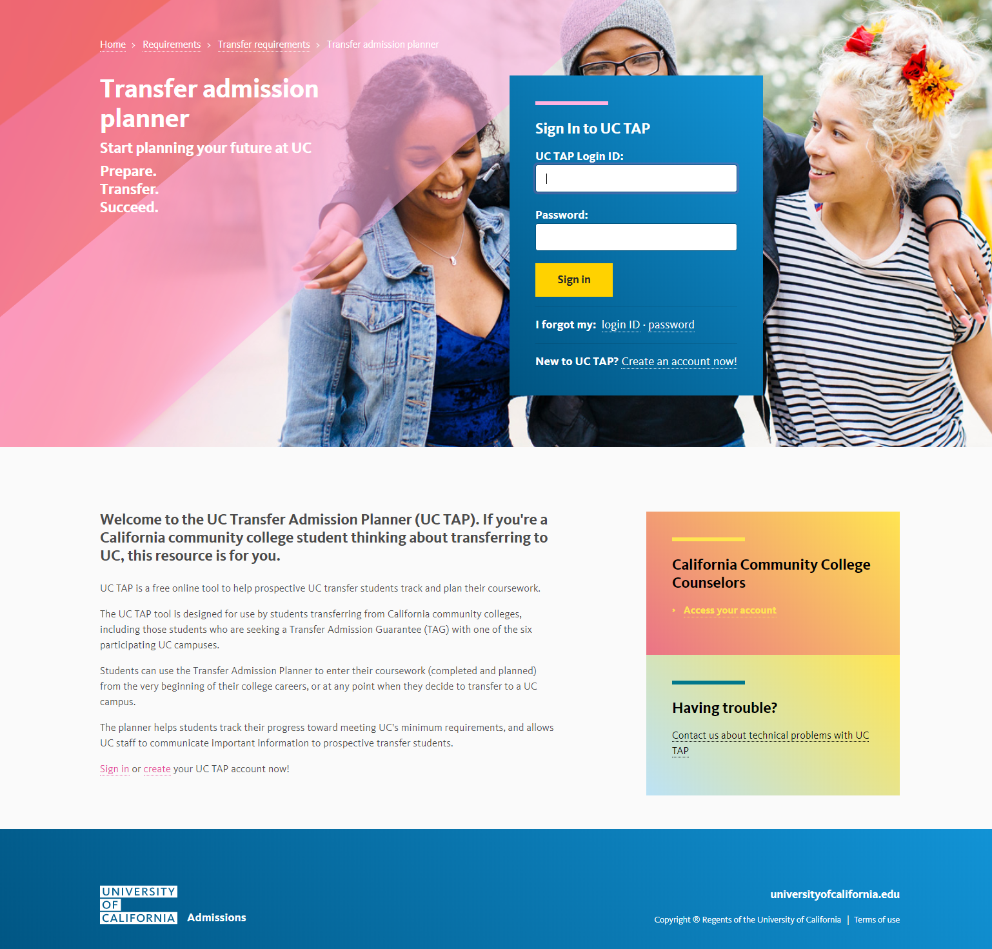
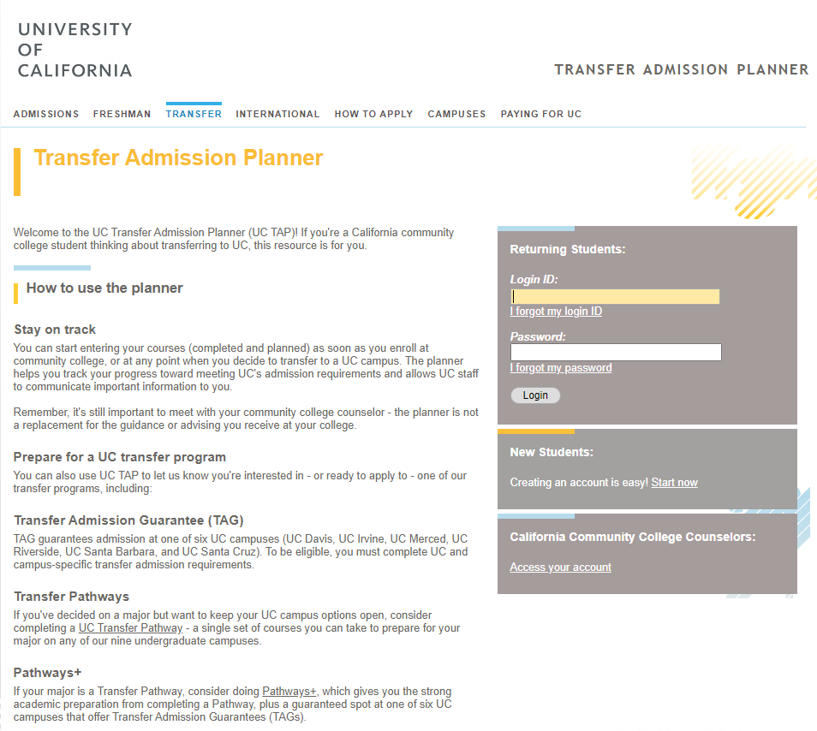
Where to Start
Go to UC Admission Planner Page at
https://uctap.universityofcalifornia.edu/students/index.cfm
Click on “Create” to create an account
OR
Click on “Sign in” to our user name and Password in the “Returning Students” and click on “login”

Slide 25
Create an Account

Slide 26
Navigate through TAP Application
“Home” page has general information about TAG, Transfer Pathway, and Pathway+, and how to start your TAP application:
The TAP application are divided into:
About me
My academic history
My Transfer Plan
Messages
Record Review
Every section you complete the link on the side bar will change color. Then you may click on the list.
The link on the sidebar is available through out the application, so you can navigate between each section.
If you have technical issues, UC can help you trouble shoot.

Slide 27
My Information
Contact information
Date of Birth
Student ID number at Cañada College (G number)

Slide 28
My Demographic
Includes:
Primary language
Residency
Whether being in Foster Care
Parents level of education
Household income in 2019 and 2020
Gender
Race and Ethnicity

Slide 29
Select any of the support programs that you participated and/or any support programs you like to participate at UC.
Support Program Involvement

Slide 30
Account Setting
To update your account setting

Slide 31
As a college student, there is no need to enter the high school courses. Click on “Add a school” to enter information
My Academic History
High school Entry

Slide 32
Click on “Add a school” to enter information Note: You must add Cañada, CSM, and Skyline college separately.
My Academic History
College Entry

Slide 33
Provide a short explanation if there is a gap between your high school graduation and First term at College. (Excluding summer term after high school graduation)
Answer the residency questions.
My Academic History

Slide 34
Coursework
You must enter every course you have completed/attempted in colleges and universities, in the United States and out of the united States. (Any course that appears on your transcript must be reported.)
Use your transcript(s) to enter:
Courses term by term and
Campus by campus
All courses including:
Non transferable courses
Repeated courses, courses with “W”, “D”, and “F” grade

Slide 35
Coursework
Click on “Add a Course
Select term from the drop down list – this list comes from the “attended” dates you entered under “colleges attended”.
Enter the term
Select the college you took the course – use the drop down
Put the course name such as Math, BIOL, ENGL, etc. then click on “search” button
A list of transferrable courses will appear that you can select from
If the course is not on the list, you may click on “add it now” to manually enter the course.

Slide 36
Coursework
When selecting the course from the list add the grade, or is in-progress or planned.
If not on the list, click on “add it now”, and enter the course information. Make sure to enter the course information correctly.
Our courses has only 3 digit numbers
Use the course title from your transcript
Enter grade, in-progress, or planned

Slide 37
Exam
You may report AP and IB exams, if applicable.
Click on “add exam”, and enter AP or IB
Click on “Search” button or click on the “View all exams”
Select the Exam from the list that appears
Enter the score, the date you took the exam
Click on “Add”
Note:
As you enter them, you will see summary of your exam at the bottom of the page.
It also indicates that whether it can be used toward the 7 course pattern or IGETC. admission or requirements
To edit your entry, you may click on the exam to update the information.
If you have a non-passing score on these exams, you do not need to enter the exam here.

Slide 38
My Transfer Plan –
Select UC Campuses You Are Interested
Under this section, you may select the UC campuses that you are interested in applying to, regardless of filing TAG application.
You may select as many as you want, 1 to 9 campuses. This is fro TAP application and not TAG yet.
Under each campus, you may select a major you wish to apply to from the drop down menu.
Select whether you are interested in TAG, UC Pathways, and/or UC Pathway+

Slide 39
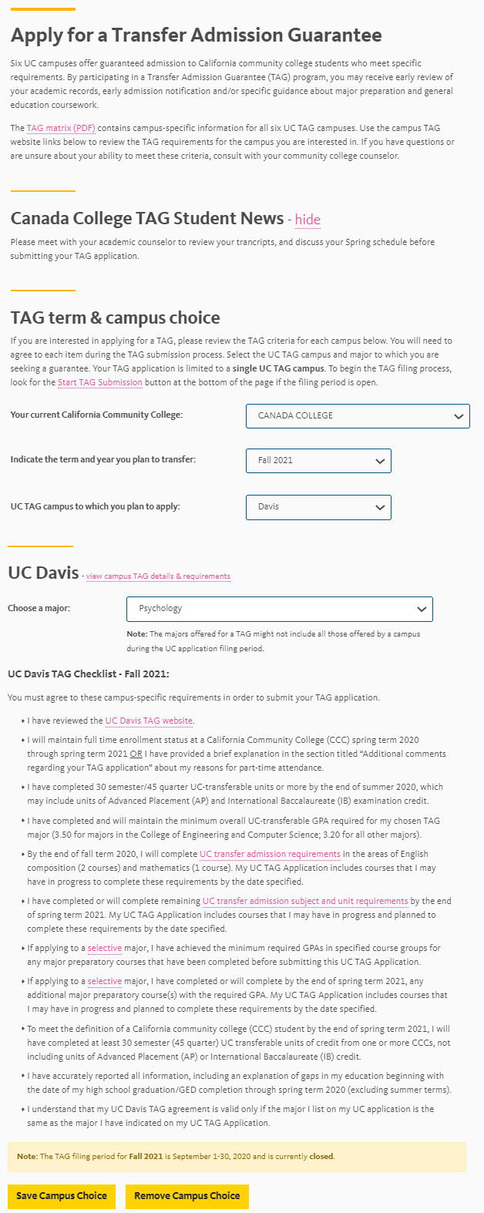
My Transfer Plan
TAG
Select your TAG major
(you must enter the same major on your UC Admission Application to the TAG campus.)
Review the TAG requirements for the selected campus
Review TAG Matrix
Enter the term you plan to file TAG
Note: You may submit your TAG application during submission period.

Slide 40
Messages
Here you may find messages from UC campuses regarding your TAP and/or TAG, if there are any.

Slide 41
Transfer Admission Planner (TAP) How-to
FYI: TAP is free! You will pay once you submit your UC application (barring waiver.)
Go to:
https://uctap.universityofcalifornia.edu/students/
Create a Login and password. This is also where you will subsequently sign-in.

Slide 42
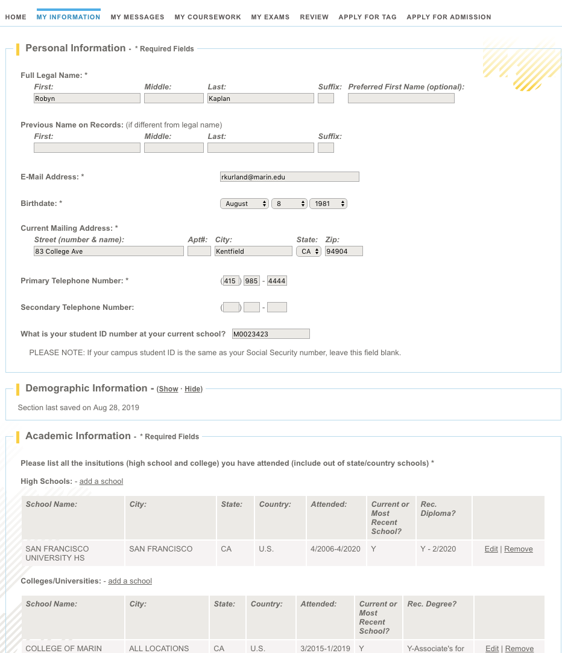
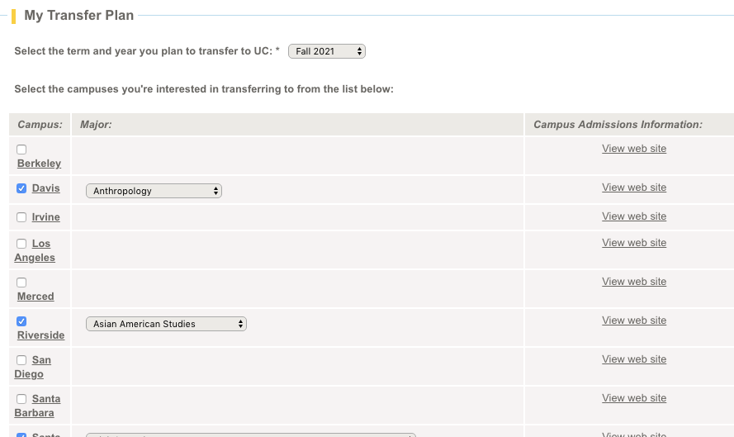
Section: My Information
Personal
Demographic
Academic (HS & College)
My Transfer Plan
Student Support Program Participation

Slide 43
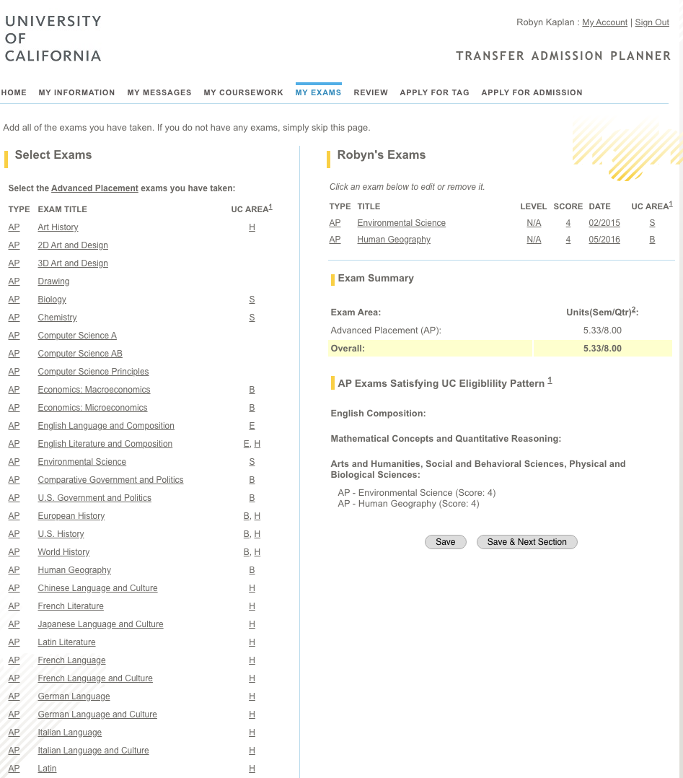
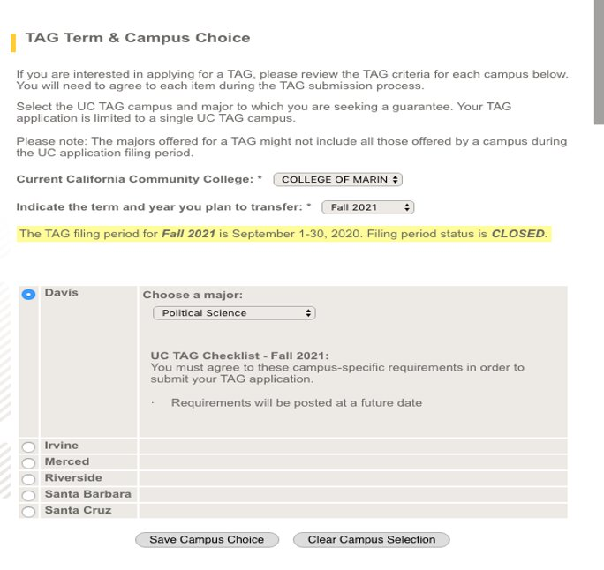
Section: My Exams
Section: Apply for TAG
You will be able to include comments at the end of the TAG application should you need to explain anything.
This is where you will add your APs, if you have any.​​

Slide 44
Section: My Coursework
You will want to list all high schools and colleges attended. This includes schools that are out-of-state or out-of-country.
If the school is not listed in the pull-down menu, enter it manually. You will also have to enter all classes taken at those schools manually as well.
You must enter ALL of your coursework! This includes classes that you have earned Fs, I's for incompletes, or W's for withdrawals. If you did academic renewal, put AR instead of D or F. Use your transcripts to fill this out.
If you repeated a class where you previously got a D or F, the system will not calculate the negative grade (but you still must put BOTH grades down).
The system pulls classes from assist.org. If it does not appear in the drop-down menu (and you took the class in CA,) it is usually not transferrable. Enter it manually.
(cont'd on next page)

Slide 45
Section: My Coursework (cont'd)
**You must put everything you have taken, regardless of the grade or whether you think it is transferrable or not.**
If you have any gaps in your education, there is a section where you can explain why.​
Note that the system checks for minimum UC eligibility.
Your GPA & transferrable units are preliminary.

Slide 46
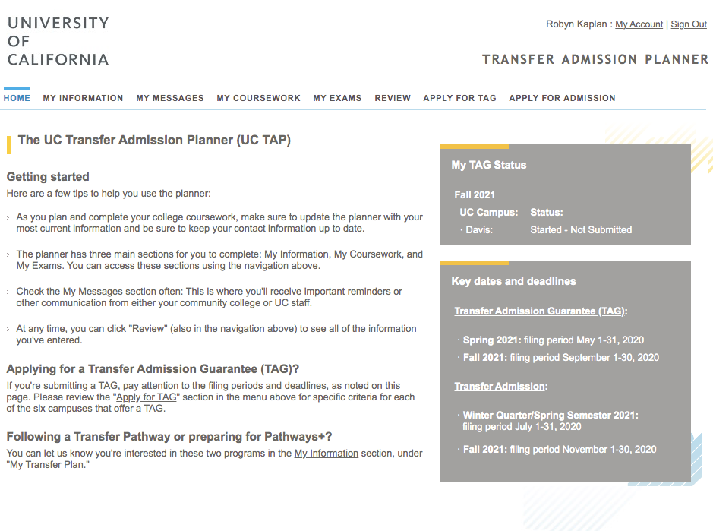
When you are ready to apply for admission, TAP will transfer your coursework onto your application for you!
You can toggle back and forth but be sure to SAVE a lot!

