Slide 1
Cal-GETC and Common Course Numbering Explained!
Sara Malmquist-West
Articulation Officer/Transfer Counselor
FLEX Spring 2025

Slide 2
Contact Info
Sara Malmquist-West
Articulation Officer/Transfer Counselor
smalmquistwest@marin.edu
COM Articulation Website
Please contact me with ANY questions!
Refer students my way!

Slide 3
In the Chat...
Name
Role (faculty, staff, administrator)
What you teach (discipline or course)
Why are you attending this session? What do you hope to get out of it?

Slide 4
AGENDA
What is Articulation?
General Education
  Cal-GETC (AB 928)
  COM's Local GE (Title 5)
  Catalog Rights
Common Course Numbering (AB 1111)
Articulation Website

Slide 5
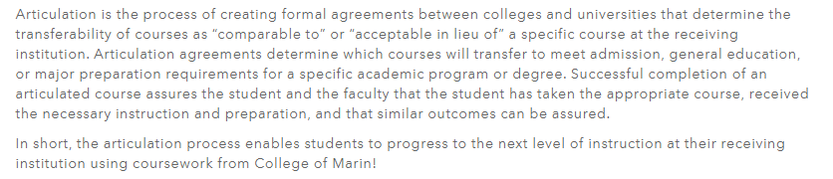
What is articulation?

Slide 6
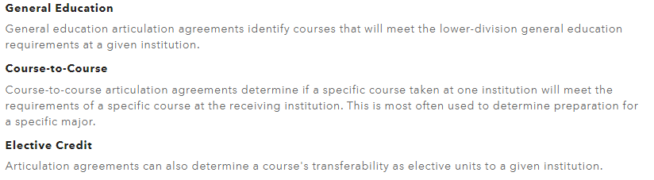
Types of Articulation agreements

Slide 7
General Education
Transition to Cal-GETC & Local GE Updates Fall 2025

Slide 8
2024-2025 General Education Patterns
Students planning to transfer* or receive an AS-T/AA-T can follow either:
IGETC (37 units) prepares students for UC/CSU or
CSU GE Breadth (39 units) prepares students for CSU
Students planning to complete local AA/AS degree:
Local COM GE (19 units)
*Students may not need to complete general education prior to transfer—especially those pursuing STEM degrees

Slide 9
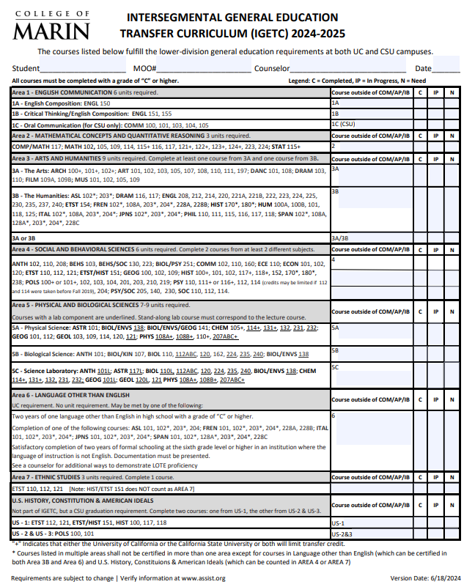
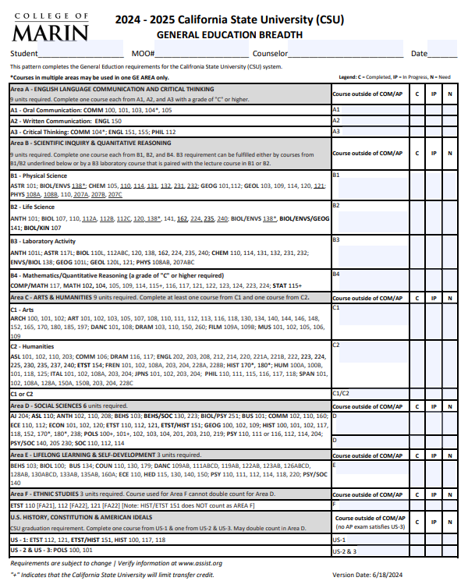

Slide 10
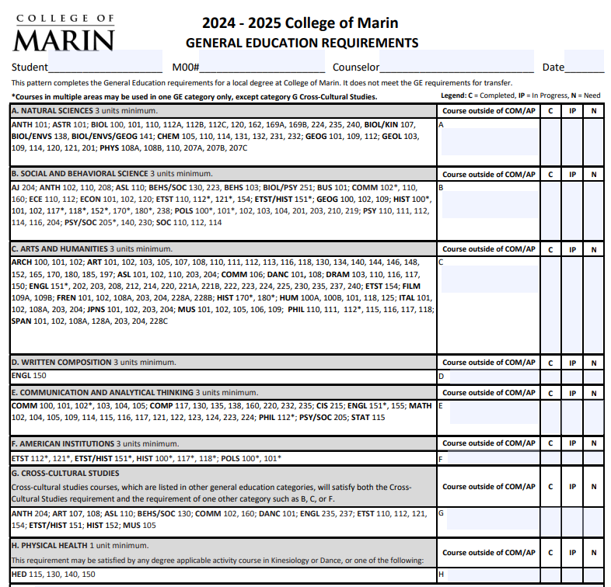
Current Local GE
Graduation Requirements
  Math competency
  English competency

Slide 11
Catalog Rights
Requirements for General Education, Degrees, and Certificates can change from academic year to academic year
Students maintain catalog rights to any year that they have attended as long as they have maintained "continuous enrollment" (which is attending one semester per academic year)
New students who start Fall 2025 must follow Cal-GETC or local GE (depending on academic goal)
Current students who started prior to Fall 2025 can follow Cal-GETC, CSU GE Breadth or IGETC (as long as they maintain catalog rights AND were not dual enrolled HS students)
Challenges:
  Each CCC determines their own catalog rights policy
  CSUs have catalog rights policy
  UCs do not have catalog rights policy
This means that students in the same class will be following different GE patterns!!!!
Please refer students to a counselor!!!
Include this information in your syllabus!

Slide 12
Cal-GETC
Transition to a singular GE Pattern for transfer

Slide 13
What is Cal-GETC?
AB 928 (Berman, 2021) called for a single lower-division General Education Pattern to determine transferability to both CSU and UC systems
New GE pattern: Cal-GETC
Implemented Fall 2025

Slide 14
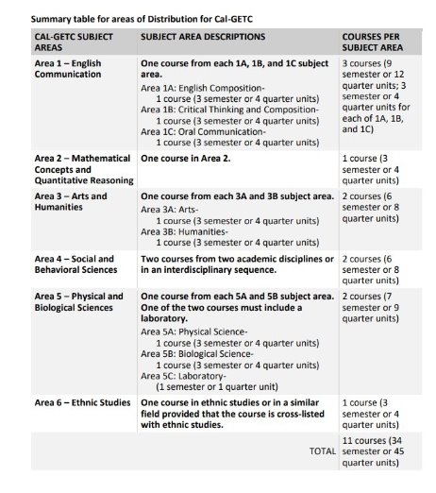
Cal-GETC
All IGETC-approved courses automatically approved for Cal-GETC (except 1C—Oral Communication)
Major changes
  34 units
  AREA 1C Oral Communications—new
  AREA 3—now 2 courses (previously 3)
  AREA E—gone (also gone at CSUs)
  Significant changes in standards
    Content
    Grades
Cal-GETC Standards
Is your course on IGETC?

Slide 15
Questions?
Cal-GETC

Slide 16
Local GE
Aligning COM's Local GE with Title 5

Slide 17
Local COM GE (Title 5 Changes)
For students planning to complete an AA/AS degree (not ADT)
  AA/AS = GE + Major courses + electives = 60 units
Per Title 5, local GE must align with Cal-GETC
  Areas NOT courses
  Update GE Philosophy & area descriptions
Per Title 5, students can meet GE for an AA/AS degree
  Local GE
  Cal-GETC (or CSU GE or IGETC w/ catalog rights)
  Completion of a BA/BS from an accredited university

Slide 18
Administration of Justice
Architecture
Art
Applied Design: Two or Three-dimensional, Occupational
Automotive Collision Repair Tech
Automotive Technology
Biology
Business, general
Communications (Filmmaking, Screenwriting, Mass Communications)
Computer Science
Court Reporting
Dance
Dental Assisting
Drama
Early Childhood Education
French
Graphic Design
Geology
Humanities
Italian
Kinesiology & Health
Liberal Arts (Social & Behavioral, Natural Sciences, Language & Communications)
Multimedia Studies
Machine and Metals Technology
Medical Assisting
Music
Nursing
Pre-Allied Health
Public Safety
Real Estate

Slide 19
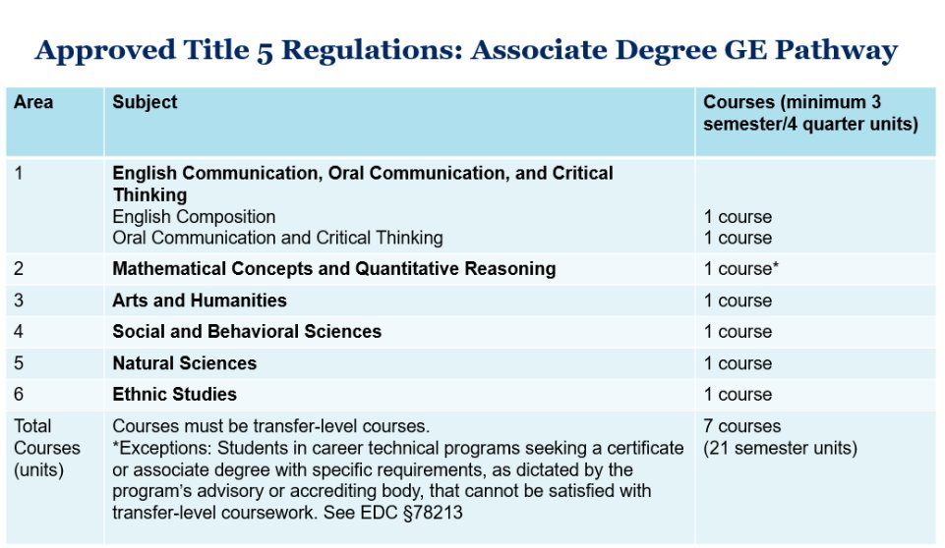

Slide 20
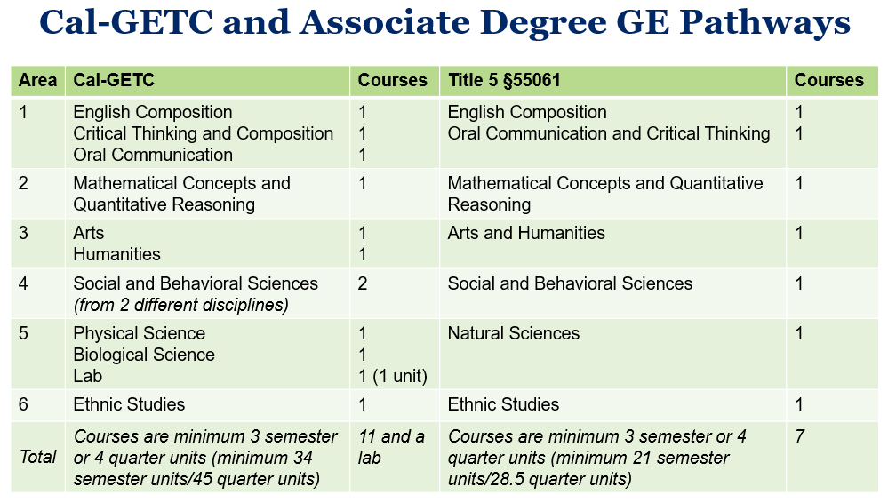

Slide 21
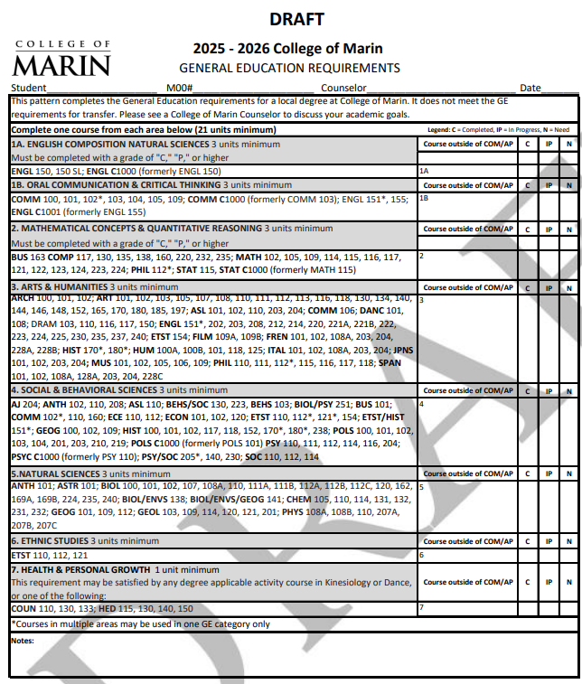
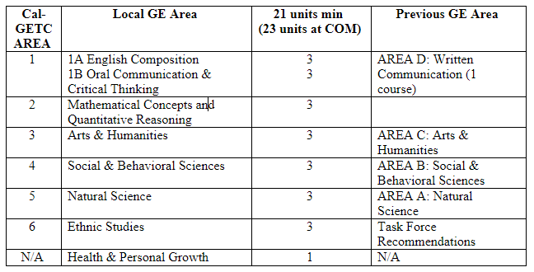
COM Local GE Pattern Fall 2025

Slide 22
Process
Spring 2024
  Ethnic Studies Task Force provided recommendations for AREA 6: Ethnic Studies
  Curriculum Committee approved "grandfather" current GE courses into corresponding area regardless of Cal-GETC approval
Fall 2025
  GE Committee (Ad Hoc Committee of Curriculum Committee, sub-committee of Academic Senate)
    GE Areas—aligned with Cal-GETC, reviewed area descriptions, all courses, proposed additional area 7
  SLOAC
    Reviewed COM's GE Philosophy and ISLOs to align with new areas
  Presented to Curriculum Committee and Academic Senate for final approval

Slide 23
Catalog Rights
Students who start Fall 2025 must follow Cal-GETC or local GE (depending on academic goal)
Students who started prior to Fall 2025 can follow Cal-GETC, CSU GE Breadth or IGETC (as long as they maintain catalog rights AND were not dual enrolled HS students)
Students maintain catalog rights to any year that they have attended as long as they have maintained "continuous enrollment" (which is attending one semester per academic year)
Challenges:
  Each CCC determines their own catalog rights policy
  CSUs have catalog rights policy
  UCs do not have catalog rights policy
This means that students in the same class will be following different GE patterns!!!!
Please refer students to a counselor!!!
Include this information in your syllabus!

Slide 24
Questions?
Local GE alignment with Title 5

Slide 25
Common Course Numbering
"Proof of Concept"
The first 6 courses

Slide 26
Common Course Numbering
AB 1111 (Berman, 2021) called for a student-facing CCN system for CCCs by July 2024
Task Force Recommendations released:
  Phase I: "Proof of Concept" to be implemented Fall 2025
CCN is NOT C-ID!
  Based on C-ID numbering to identify courses, but NOT the same numbers or templates!

Slide 27
Why common course numbering?
The current system is confusing for students!
Example: The following courses all meet the College Composition (CSU GE A2, IGETC 1A & UC-E, Local GE AREA D/English Proficiency) which has the C-ID ENGL 100:
  COM: ENGL 150
  SRJC: ENGL 1A
  NVC: ENGL 120

Slide 28
What is C-ID?
"Course Identification Descriptor"
Current number system designed to make the transfer of courses and articulation easier
"Reciprocity agreement" among CCCs and participating CSUs
Required for Associates Degrees for Transfer (ADTs)
Example: The following courses all meet the C-ID ENGL 100 College Composition
  COM: ENGL 150
  SRJC: ENGL 1A
  NVC: ENGL 120
C-ID does NOT include:
  UC transferability
  CSU/IGETC/Cal-GETC GE Area
  Major preparation

Slide 29
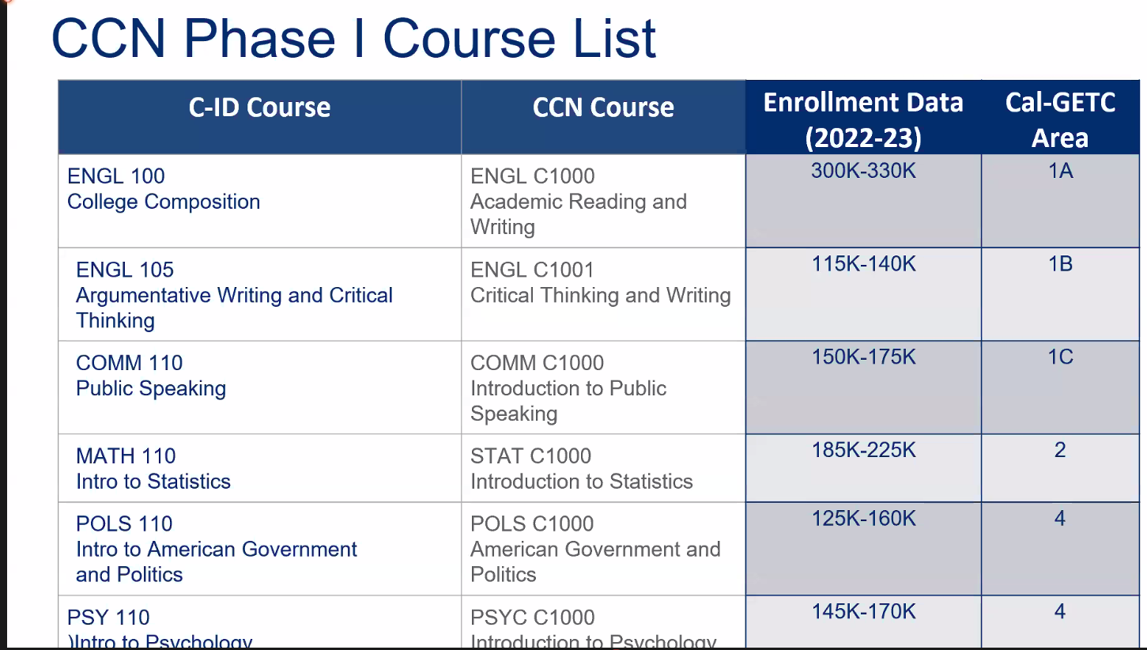

Slide 30
CCN Proof of Concept
COM Course | CCN Course
COMM 103: Public Speaking | COMM C1000: Introduction to Public Speaking
ENGL 150: College Writing and Reading (1A) | ENGL C1000 Academic Reading and Writing
ENGL 155: Critical Thinking and Composition | ENGL C1001 Critical Thinking and Writing
MATH 115: Probability and Statistics | STAT C1000 Introduction to Statistics
POLS 101: Introduction to the Government of the United States | POLS C1000: American Government and Politics
PSY 110: Introduction to Psychology | PSYC C1000: Introduction to Psychology

Slide 31
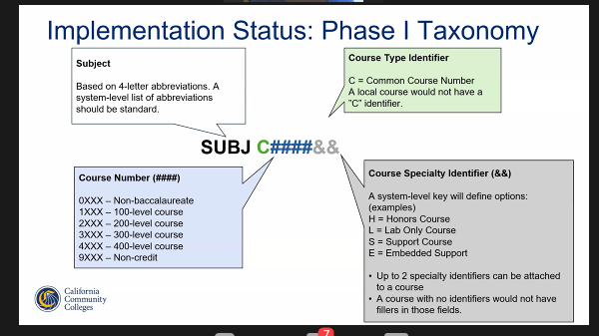

Slide 32
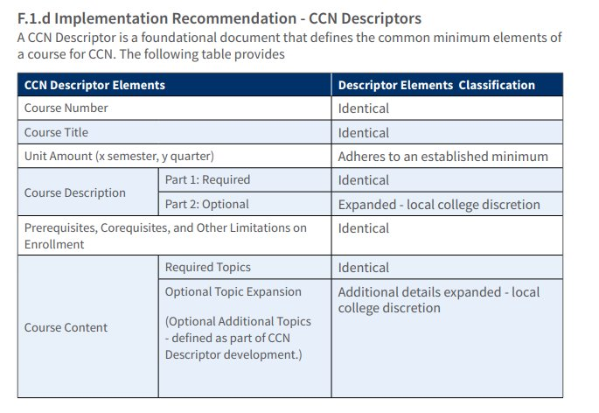
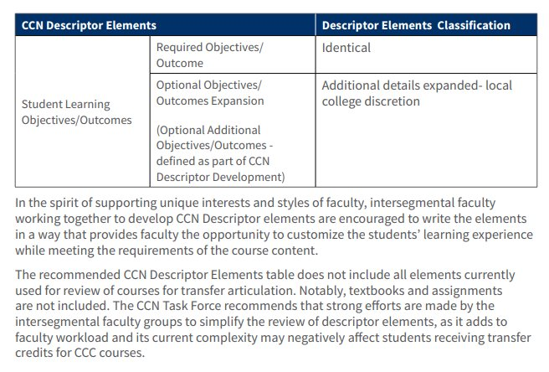
CCN Descriptors

Slide 33
CCN Templates
https://www.cccco.edu/About-Us/Chancellors-Office/Divisions/Educational-Services-and-Support/course-outline-of-records-submission

Slide 34
Timeline: Phase I
15 Aug.
Descriptors released
Fall 2024
"Revised courses" (new prefixes, number, COR, etc.) go through curriculum & updated in eLumen
Fall 2025
CCN courses in catalog
Spring 2025
Pending Cal-GETC submissions
COMM courses—will have a chance to re-submit
ENGL 150
ENGL 155
PSY 110
POLS 101
MATH 115
COMM 103

Slide 35
College-wide Impact
Cal-GETC, local GE & CCN all at the same time!
Banner
DegreeWorks
ELumen
Catalog
ADT Resubmissions
  Narratives

Slide 36
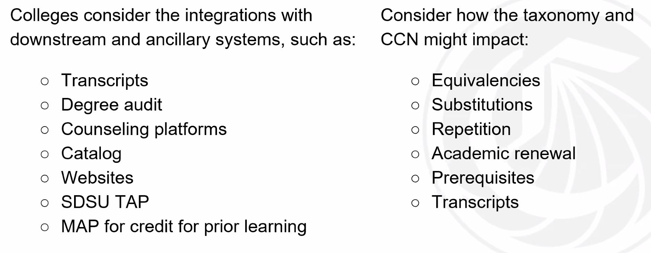
Systems-Wide Impact

Slide 37
Stop!
Proof of concept
I cannot emphasize enough that this is a Proof of Concept!
  "Building the plane while we are flying it..."
  "It's a bit of a hot mess..."
The following slides are speculations based on the guidance we have received from the Chancellor's office and the AB1111 Task Force Recommendations
Stay tuned for updates regarding confirmation of Phase II!
Don't do anything to your curriculum yet!

Slide 38
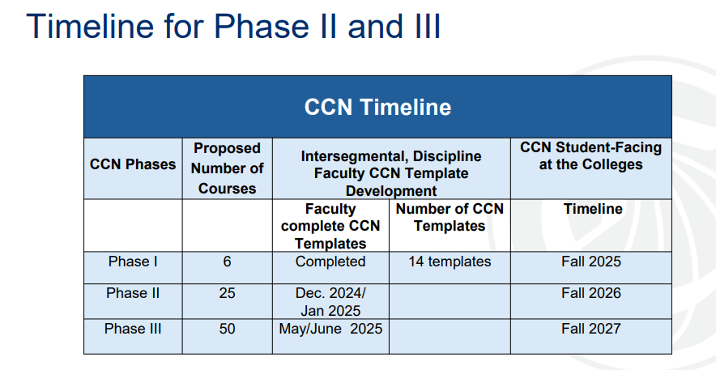

Slide 39
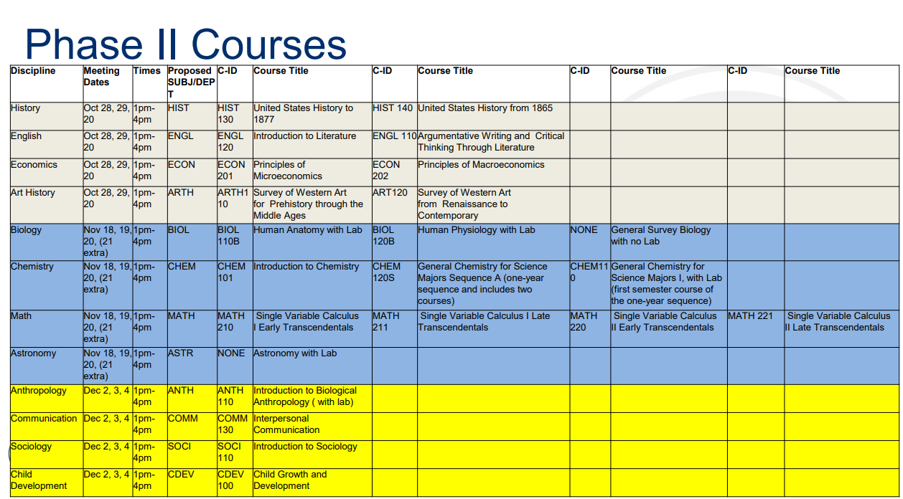

Slide 40
Phase II Courses at COM
CHEM 114: Introduction to Chemistry
CHEM 131: General Chemistry I
CHEM 132: General Chemistry II
MATH 123: Analytic Geometry and Calculus I
MATH 124: Analytic Geometry and Calculus II
ASTR 101: Introduction to Astronomy
ASTR 117L: Introduction to Astronomy Lab
ANTH 101: Introduction to Physical/Biological Anthropology
ANTH 101L: Physical/Biological Anthropology Lab
COMM 102: Intercultural Communications
SOC 110: Introduction to Sociology
ECE 110: Child Development
HIST 117: History of the United States I
HIST 118: History of the United States II
ENGL 151: Advanced College Writing about Literature (1B)
ECON 101: Principles of Macroeconomics
ECON 102: Principles of Microeconomics
ART 101: History of Art: Ancient – Medieval
ART 102: History of Art: Medieval – 19th C.
ART 103: History of Art: 19th – 20th C.
BIOL 120: Human Anatomy
BIOL 224: Human Physiology
BIOL 110: Introduction to Biology
BIOL 110L: Introduction to Biology Lab

Slide 41
Get Involved!
At some point the ASCCC will be sending out calls for faculty volunteers to take part in the development of the CCN templates for the first six CCN courses to be developed this summer. While those calls haven’t been sent yet, you can encourage your faculty who may be interested in volunteering for this work to sign up for discipline-specific listservs operated by the Academic Senate for California Community Colleges (https://www.asccc.org/sign-our-newsletters). Just scroll to the bottom of the website to find the registration form.
If you have any questions about the listservs, pleases contact the ASCCC at info@asccc.org.

Slide 42
Questions?
Common Course Numbering

Slide 43
Articulation Website
Check out "Faculty Resources"

Slide 44
Questions?

