Slide 1
El Camino College

Slide 2
AGENDA
Historically Black College & Universities (HBCU) Background and History
HBCU Facts
Why Students Should Consider HBCU Transfer Option?
Well Known Alumni
HBCU Transfer Admissions Guarantee Agreement & Advantages
HBCU / California Community College Partners
Next Steps
Cost Of Attending An HBCU Partner
Apply For Free
How To Learn More About HBCU’s
Questions & Answers

Slide 3
HISTORY OF HBCU’S
The first Historically Black Colleges (HBCUs) were established prior to the Civil War.
Cheyney University of Pennsylvania (1837)
Lincoln University in Pennsylvania (1854)
Wilberforce University in Ohio (1856).
However, most Historically Black Colleges and Universities were established after the American Civil War. By 1902, 85 HBCU’s had been established.
Currently there are 105 Historically Black Colleges and Universities located mainly in the South and on the East Coast.
HBCU’s were established because most Colleges and Universities denied admission to African Americans.

Slide 4
HBCU Facts
How Many African Americans Are HBCU Graduates?
22% of Bachelors Degree Holders
40% of Members of Congress
12.5% of CEO’s
40% of Engineers
50% of Professors at Non-HBCU Institutions
50% of Lawyers
80% of Judges
(Diverse Issues in Higher Education, September 9th 2015)

Slide 5
WHY CONSIDER A HBCU?
HBCU’s (37.8%) are doing a better job of graduating low-income Black students than PWI’s (32%).¹
About 55% of Black HBCU graduates said they “strongly agreed” that their HBCU “prepared them well for life outside of college,” compared to less than 30 % of non-HBCU Black graduates.²
While 20% of Black graduates who did not attend an HBCU said they were “thriving in financial well being,” 51% of Black HBCU graduates reported doing so.²
1. NPR Code Switch (March 1, 2017) by Andrew H. Nichols and Denzel Evans-Bell of The Educational Trust titled “ A Look at Black Student Success”
2. “Inside Higher Education” October 2015 according to a survey of 50,000 college alumni

Slide 6
WHY CONSIDER A HBCU?
Black graduates from HBCU’s are more likely to have a mentor who encouraged their goal and a professor who cared about them as a person.¹
Alumni are more likely to have a job or an internship where they apply what they learned.¹
HBCU’s offering Engineering graduate African Americans at a rate of 62% to 94%, while PWI’s graduate African American Engineering majors at a rate of 4% to 8%²
https://www.pbs.org/newshour/show/the-next-generation-of-african-american-doctors-finds-success-and-support-at-this-university
1. As reported in the wwwhuffingtonpost.com May 27, 2016
2. Reported in “Diverse Issues in Higher Education” – February 23, 2016

Slide 7
WHY CONSIDER A HBCU?
Low teacher to student ratio
Most classes are taught by professors not teaching assistants
Long term income earnings are higher for students who attended HBCU’s. (Huffingtonpost.com 5/27/16)
Memorable social experiences such as battle of the bands, step shows, and homecoming.
Competitive Tuition Costs
Longer Application Periods
Graduate School Opportunities and Employment Opportunities
Diversity – students from all over the US and the world

Slide 8
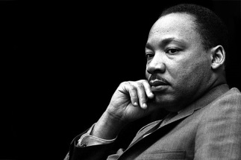
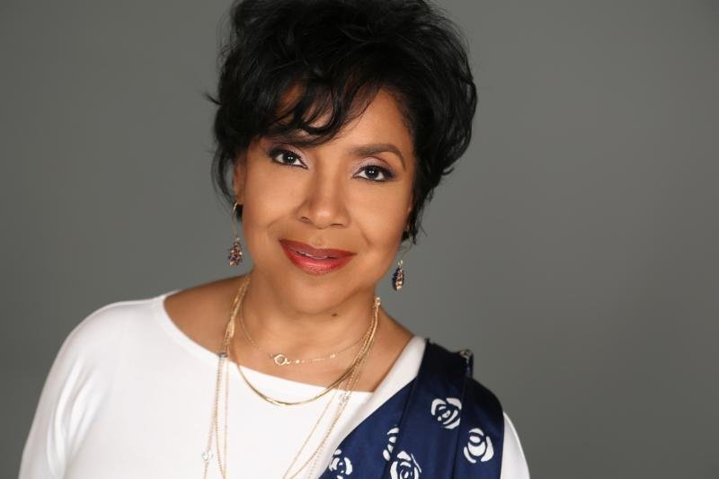
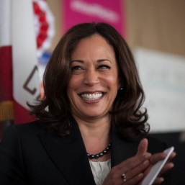
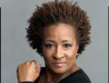
WELL KNOWN HBCU ALUMNI
Martin Luther King, Kamala Harris, Alice Walker,
Taraji P Henson, Spike Lee, 2 Chainz
Oprah Winfrey, Common, Phylicia Rashad
Samuel L. Jackson, Michael Strahan, Diddy (Sean Combs)
Thurgood Marshall

Slide 9
HISTORICALLY BLACK COLLEGE AND UNIVERSITY TRANSFER AGREEMENT PROJECT
Guaranteed Admission for any California Community College student who completes one of the following:
A transfer level Associate Degree* awarded by a California Community College with a minimum cumulative grade point average (GPA) of 2.5 or higher
(OR)
A minimum 30 transferrable semester units with a minimum grade point average (GPA) of 2.5 or higher.
*The degree must include both the completion and certification of lower division Intersegmental General Education Transfer Curriculum (IGETC) or the California State University General Education Breath pattern9 (CSU GE)

Slide 10
ADDITIONAL STUDENT ADVANTAGES
IN ADDITION TO THE ACCEPTANCE OF TRANSFERABLE UNITS STUDENTS RECEIVE:
Pre-transfer advisement
Priority consideration for campus housing
Priority consideration for scholarships for students with a 3.2 GPA or higher based on available funding.

Slide 11
Began with nine HBCUs in 2015, now there are thirty-nine California Community College HBCU Partners!
Alabama State University, AL
Alcorn State University, MS
Arkansas Baptist College, AK
Benedict College, SC
Bethune- Cookman University, FL
Bennett College, NC
Bowie State University, MD
Claflin University, SC
Clark Atlanta University, GA
Central State, OH
Dillard University, LA
Edward Waters College, FL
Fisk University, TN
Florida Memorial University, FL
Fort Valley State University, GA
Grambling State University, LA
Hampton University, VA
Harris-Stowe State University, MO
Houston-Tillotson, TX
Kentucky State University, KY
Lane College, TN
Lincoln University, MO
Lincoln University, PA
Mississippi Valley State University, MS
North Carolina Central University, NC
Shaw University, NC
Philander Smith College, AK
Southern University and A&M College, LA
Southern University at New Orleans, LA
Stillman College, AL
Talladega College, AL
Tennessee State University, TN
Texas Southern University, TX
Tougaloo College, MS
Tuskegee University, AL
Virginia State University, VA
West Virginia State, WV
Wiley College, TX
Xavier University of Louisiana, LA

Slide 12
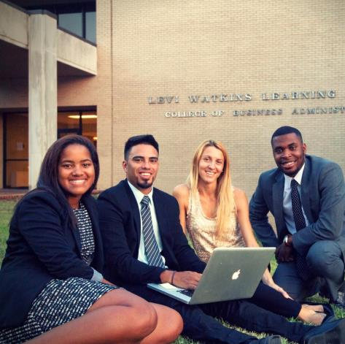
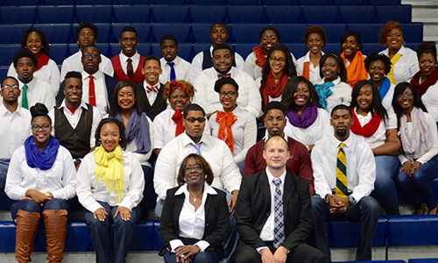
C
Partner HBCUs In The
State of Alabama
Tuskegee University
Private -Tuskegee, Alabama
Enrollment: 3,050
Gender:61/39%(Female)
Student-Faculty Ratio:13:1
Average Class Size: 20
Cost: $42,000
Degree Programs: 68
FACT:
Tuskegee Univ. produces 75% of African American Veterinarians in the world
Alabama State University
Public - Montgomery, Alabama
Enrollment: 4190
Gender:62/38 (Female)
Student-Faculty Ratio: 15:1
Average Class Size: 20-45
Cost:$31,000
Degree Programs: 63
FACT:
ASU was founded by nine free slaves with $500
Talladega College
Private - Talladega, Alabama
Enrollment: 782
Gender:53/47 (Female)
Student-Faculty Ratio: 12:1
Average Class Size: 20
Cost:$19,000
Degree Programs: 17
FACT:
Talladega is home of the Amistad Murals by artist Hale Woodruff
Stillman College
Private - Talladega, Alabama
Enrollment: 690
Gender:55/45 (Female)
Student-Faculty Ratio:17:1
Average Class Size: 10-15
Cost:$23,000
Degree Programs: 17
FACT:
The renowned Stillman College Choir has performed all over the US and abroad
Notes:
Tuskegee:
Notable Alumni
Interesting Facts

Slide 13
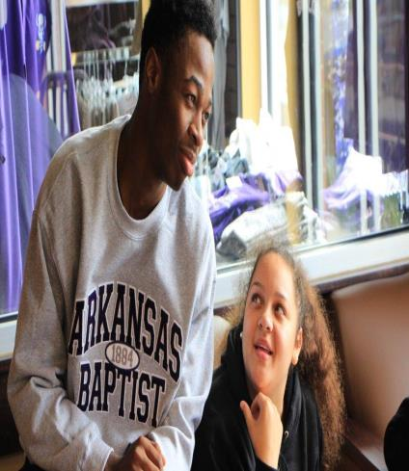
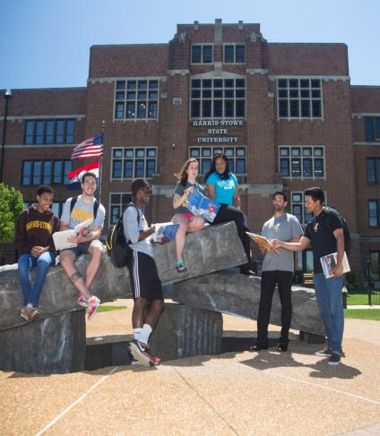
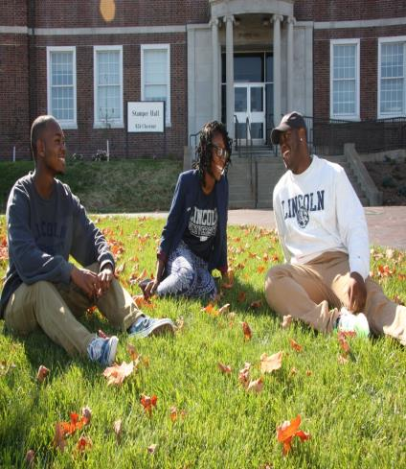
Partner HBCUs In The
States of Arkansas and Missouri
Philander Smith College
Private – Little Rock, Arkansas
Enrollment: 890
Gender: 62/38% (Female)
Student-Faculty Ratio:16:1
Average Class Size: 20
Cost:$21,000
Degree Programs: 20
FACT:
In Feb. 2019 Alpha Kappa Alpha presented PSC with a first installment Endowment of $100,000
Arkansas Baptist College
Private – Little Rock, Arkansas
Enrollment: 590
Gender:63/37% (Male)
Student-Faculty Ratio:22:1
Average Class Size: 25
Cost:$ 17,000
Degree Programs: 13
FACT:
The Main Building on campus, built in 1893, is one of the oldest surviving academic buildings in the state, and was listed on the National Register of Historic Places in 1976
Harris Stowe State University
Public – St. Louis, Missouri
Enrollment: 1700
Gender: 67/33% (Female)
Student-Faculty Ratio: 15:1
Average Class Size: 30
Cost:$20,000
In-State Tuition Offered
Degree Programs: 50
FACT:
The University has more than doubled its degree production of STEM graduates between 2003-08 and 2008-2015
Lincoln University – Missouri
Public – Jefferson City, Missouri
Enrollment: 2600
Gender:
Student-Faculty Ratio:
Average Class Size: 20-45
Cost:$28,000
In-State Tuition Offered
Degree Programs: 70
FACT:
Institution was founded by a group of soldiers and officers of the 62nd US Colored Infantry

Slide 14
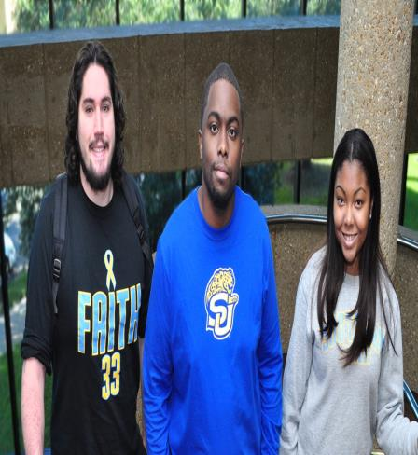
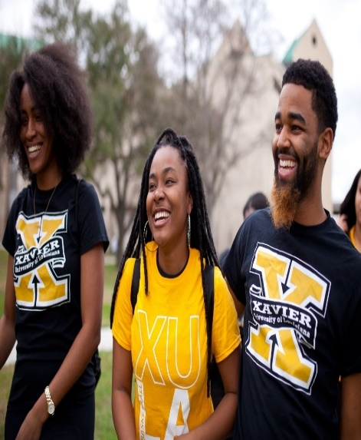
Partner HBCUs In The
State of Louisiana
Dillard University
Private – New Orleans, Louisiana
Enrollment: 1300
Gender: 75/25$ (Female)
Student-Faculty Ratio: 11:1
Average Class Size: 20
Cost:$26,000
Degree Programs: 22
FACT:
Dillard University is in the top 20% of national liberal arts universities and is ranked #11 among HBCU's.
Grambling State University
Public – Grambling, Louisiana
Enrollment: 5200
Gender: 63/37% (Female)
Student-Faculty Ratio: 25
Average Class Size: 20
Cost: $18,850
In-State Tuition Offered
Degree Programs: 42
FACT:
GSU is number one in the state for producing African American Computer Information System(CIS) and Engineering Majors
Southern University and A&M College
Public – Baton Rouge, Louisiana
Enrollment: 6600
Gender: 65/35% (Female)
Student-Faculty Ratio: 15:1
Average Class Size: 30
Cost: $18,500
In-State Tuition Offered
Degree Programs: 55
FACT:
The College of Engineering is among the top 10 producers of African-American students who receive undergraduate degrees in engineering.
Xavier University of LA
Private – New Orleans, Louisiana
Enrollment: 3200
Gender:
Student-Faculty Ratio: 14:1
Average Class Size: 20
Cost:$22,500
Degree Programs: 45
FACT:
#1 in the nation in the number of African American graduates who go on to complete medical school (AAMC data 2019)
Notes:
More XULA FACTS:
Among the nation's top four colleges of pharmacy in graduating African Americans with Doctor of Pharmacy (Pharm D) degrees. (2018)
#1 in the nation in awarding bachelor's degrees to African American students in the biological and biomedical sciences, the physical sciences, and physics. (2018)
#3 in the nation in the number of African American graduates who go on to earn a Ph.D. in science and engineering disciplines. (2018)

Slide 15
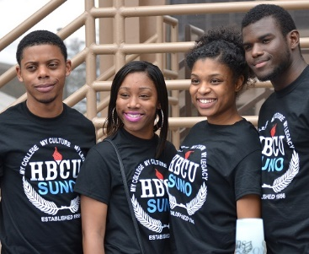
Partner HBCUs In The
States of Louisiana and Florida
Southern University
New Orleans
Public – New Orleans, Louisiana
Enrollment: 2300
Gender: 71/29% (Female)
Student-Faculty Ratio: 20:1
Average Class Size: 25
Cost:$22,000
In-State Tuition Offered
Degree Programs: 20
FACT:
Since the campuses recovery from Hurricane Katrina the SUNO campus has had eight new buildings constructed and now open for use
Bethune-Cookman University
Private – Daytona Beach, Florida
Enrollment: 3990
Gender: 62/38% (Female)
Student-Faculty Ratio: 16:1
Average Class Size: 35
Cost:$ 30,000
Degree Programs: 36
FACT:
In 1904 Mary McLeod Bethune opened Daytona Literary and Industrial Training school for Negro girls with $1.50, five girls and Faith in God…which later would become BCU
Edward Waters
Private – Jacksonville, Florida
Enrollment: 1000
Gender: 52/48% (Female)
Student-Faculty Ratio:17:1
Average Class Size: 15-20
Cost:$23,700
Degree Programs: 8
FACT:
Edward Waters College (EWC) is, distinctively, Florida’s oldest independent institution of higher learning as well as the state’s first institution established for the education of African Americans
Florida Memorial University
Private – Miami Gardens, Florida
Enrollment: 1250
Gender: 62/38% (Female)
Student-Faculty Ratio: 14:1
Average Class Size: 20
Cost:$22,000
Degree Programs: 30
FACT:
Barrington Levy, an FMU alum, was the first black person and youngest pilot to fly around the world in 2007

Slide 16
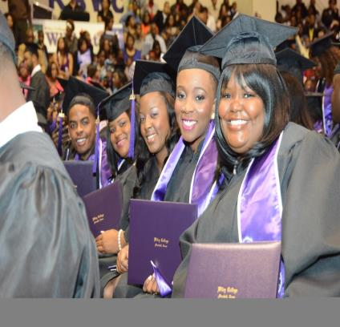
Partner HBCUs In The
States of Texas & Ohio
Huston-Tillotson University
Private – Austin, Texas
Enrollment: 1050
Gender: 66/34% (Female)
Student-Faculty Ratio: 15:1
Average Class Size: 20
Cost: $22,000
Degree Programs: 18
FACT:
The University also offers alternative teacher certification and academic programs for undergraduates interested in pursuing post-graduate degrees in Law and Medicine
Texas Southern University
Public – Houston, Texas
Enrollment: 9200
Gender: 58/42% (Female)
Student-Faculty Ratio: 18:1
Average Class Size: 25-30
Cost: $37,800
Degree Programs: 100
FACT:
TSU is a leading producer of college degrees to African Americans and Hispanics in Texas and ranks fourth in the United States in doctoral and professional degrees conferred to African Americans
Wiley College
Private – Marshall, Texas
Enrollment: 1200
Gender: 60/40% (Female)
Student-Faculty Ratio: 18:1
Average Class Size: 20
Cost:$20,500
Degree Programs: 15
FACT:
The movie “The Great Debaters directed and starring Denzel Washington was based on four students at Wiley College
Central State University
Public – Wilberforce, Ohio
Enrollment: 2000
Gender: 60/40% (Female)
Student-Faculty Ratio: 13:1
Average Class Size: 15-20
Cost: $22,000
Degree Programs: 30
FACT:
In the Fall of 2019 a new campus residence hall expands to include a 250-bed apartment style residential hall and a 10,000 sq.ft. Wellness Center

Slide 17
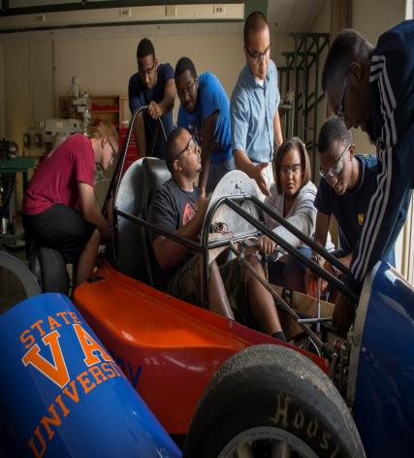
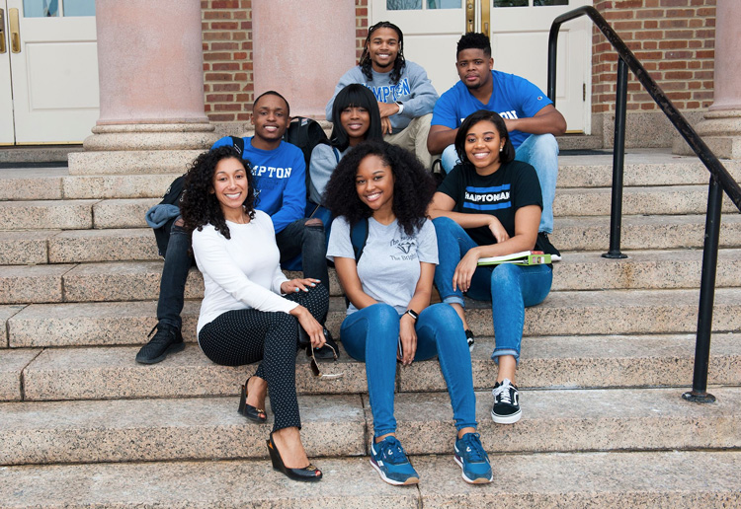
Partner HBCUs in the
States of Virginia, West Virginia and
Pennsylvania
West Virginia State University
Public – Institute, West Virginia
Enrollment: 3690
Gender: 54/46% (Female)
Student-Faculty Ratio: 14:1
Average Class Size: 25
Cost: $30,200
Degree Programs: 29
FACT:
The first of 6 HBCU’s Authorized by the Civil Aeronautics Authority to establish aviation program.
Virginia State University
Public – Petersburg, Virginia
Enrollment: 4600
Gender: 58/42% (Female)
Student-Faculty Ratio: 17:1
Average Class Size: 20
Cost:$32,450
Degree Programs: 50
FACT:
Alumna Dr. Lataisia C. Jones has become the first African-American student to graduate from Florida State University with a Ph.D. in Biomedical Sciences
Hampton University
Private – Hampton, Virginia
Enrollment: 4300
Gender: 67/33% (Female)
Student-Faculty Ratio: 13:1
Average Class Size: 25
Cost: $40,000
Degree Programs: 80
FACT:
Emancipation Oak on HU Campus was the site of the first southern reading of the Emancipation Proclamation in 1863 and designated one of the 10 greatest trees in the world by National Geographic Society
Lincoln University of PA
Public – Oxford, Pennsylvania
Enrollment: 2100
Gender: 66/34% (Female)
Student-Faculty Ratio: 15:1
Average Class Size: 20-25
Cost: $26,500
In-State Tuition Offered
Degree Programs: 35
FACT:
Lincoln University received its charter from the Commonwealth of Pennsylvania on April 29, 1854, making it the nation's first degree-granting Historically Black College and University (HBCU)

Slide 18
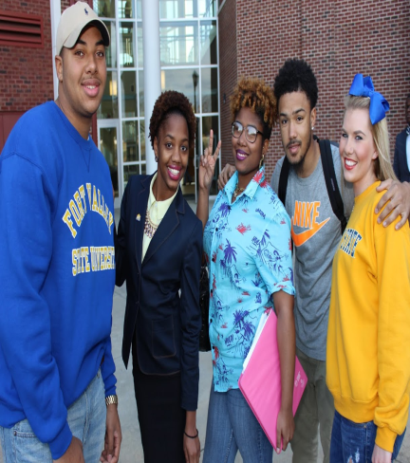
Partner HBCUs In The
States of Georgia and South Carolina
Clark Atlanta University
Private – Atlanta, Georgia
Enrollment: 3500
Gender: 74/26% (Female)
Student-Faculty Ratio: 15:1
Average Class Size:
Cost: $33,500
Degree Programs: 38
FACT:
In April 0f 2019 CAU entered into a 3+3 program with Syracuse University College of Law – students finish the bachelors and Juris doctor degree in an accelerated format
Fort Valley State University
Public – Fort Valley, Georgia
Enrollment: 2700
Gender: 62/38% (Female)
Student-Faculty Ratio:21:1
Average Class Size: 20
Cost: $21,000
Degree Programs: 50
FACT:
FVSU has been the nation’s top producer of African Americans in mathematics and related majors in 2 of the past 3 years.
Claflin University
Private – Orangeburg, South Carolina
Enrollment: 2200
Gender: 68/32% (Female)
Student-Faculty Ratio: 14:1
Average Class Size: 20
Cost: $27,000
Degree Programs: 41
FACT:
Claflin share’s the same founder of Boston University and offer students semester long Exchange Program at no additional cost
Benedict College
Private – Columbia, South Carolina
Enrollment:2100
Gender: 52/48% (Female)
Student-Faculty Ratio: 19:1
Average Class Size: 15
Cost: $23,000
Degree Programs: 33
FACT:
Benedict was ranked 1 of the top 10 colleges in the nation in producing African Americans with an undergraduate Physics degree, as reported by the Education and Employment Statistic Division of the American Institute of Physics

Slide 19
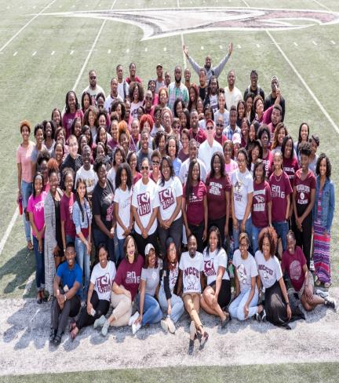
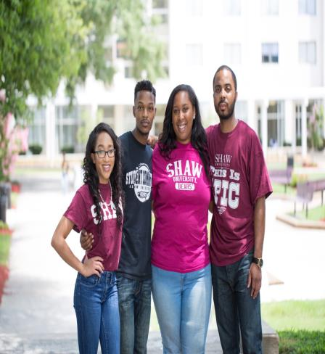
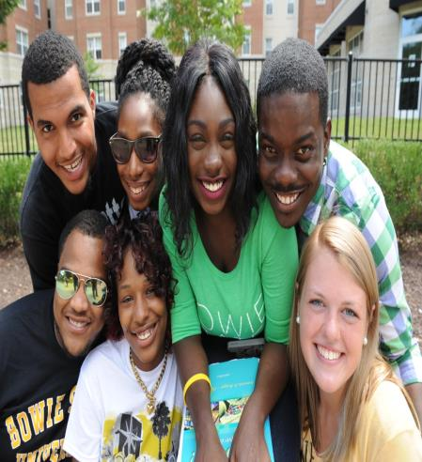
Partner HBCUs in the
States of North Carolina and Maryland
Bennett College
Private Women's – Greensboro, North Carolina
Enrollment: 465
Gender: 100% (Female)
Student-Faculty Ratio: 7:1
Average Class Size: 15
Cost:$29,813
Degree Programs: 15
FACT:
Bennett College has a new, state-of-the-art TV and photography studio that will enable Bennett Belles to remain on the cutting edge of media production
North Carolina Central University
Public – Durham, North Carolina
Enrollment:8,011
Gender: 67/33% (Female)
Student-Faculty Ratio: 16:1
Average Class Size: 23
Cost: $22,000
Degree Programs: 81
FACT:
The University has two state-of-the-art biotechnology research facilities which collaborate with pharmacy and biotech companies in nearby Research Triangle Park
Shaw University
Private – Raleigh, North Carolina
Enrollment: 1400
Gender: 57/43% (Female)
Student-Faculty Ratio: 16:1
Average Class Size: 25
Cost: $24,260
Degree Programs: 30
FACT:
With a history of leadership, activism and service which is well documented, The Student Non-Violent Coordinating Committee (SNCC) was established on Shaw’s campus in 1960
Bowie State University
Public – Bowie, Maryland
Enrollment: 6300
Gender: 58/42 (Male)
Student-Faculty Ratio: 16:1
Average Class Size: 35
Cost: $23,000
Degree Programs: 43
FACT:
Bowie State’s Cybersecurity programs are recognized by the National Security Agency and the Department of Homeland Security as models of excellence.

Slide 20
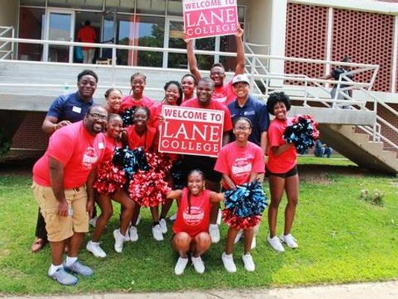
Partner HBCUs In The
States of Tennessee and Kentucky
Fisk University
Public – Nashville, Tennessee
Enrollment: 660
Gender: 68/32% (Female)
Student-Faculty Ratio: 10:1
Average Class Size: 20
Cost: $30,000
Degree Programs: 24
FACT:
Fisk University has a series of unique elite corporate partnerships with Google, HCA Healthcare, Alliance Bernstein and Cravath, Swaine & Moore
Tennessee State University
Public – Nashville, Tennessee
Enrollment: 7770
Gender: 62/38% (Female)
Student-Faculty Ratio: 14:1
Average Class Size: 30
Cost: $27,500
Degree Programs: 83
FACT:
Notable Alumni include 1960 Olympic Sprint Champion Wilma Rudolph, cell phone microchip inventor Jesse Russell and of course media mogul Oprah Winfrey
Lane College
Private – Jackson, Tennessee
Enrollment: 2100
Gender: 52/48% (Female)
Student-Faculty Ratio: 17:1
Average Class Size: 15
Cost:$20,000
Degree Programs: 16
FACT:
Lane is one of only two private Colleges or Universities in West Tennessee with its own radio station
Kentucky State University
Public – Frankfort, Kentucky
Enrollment: 1800
Gender:59/40% (Female)
Student-Faculty Ratio: 12:1
Average Class Size: 25
Cost:$16,500
Degree Programs: 45
FACT:
KSU embodies the most diverse mix in the Commonwealth of Kentucky. More than 40 percent of KSU students represent various ethnicities besides African American, including those from Central America, Africa and Asia

Slide 21
Partner HBCUs In The
State of Mississippi
Alcorn State University
Public – Lorman, Mississippi
Enrollment: 4000
Gender: 64/36% (Female)
Student-Faculty Ratio: 16:1
Average Class Size: 25
Cost: $25,000
*No Out-of-State Fee
Degree Programs: 13
FACT:
Alcorn is the oldest public historically black land-grant institution in the United States and the second-oldest state-supported institution of higher learning in Mississippi
Mississippi Valley State University
Public – Itta Bena, Mississippi
Enrollment: 2200
Gender: 61/39% (Female)
Student-Faculty Ratio: 15:1
Average Class Size: 25
Cost: $15,000
*No Out-of-State Fee
Degree Programs:
FACT:
Mississippi Valley State University graduates more Mississippi educators than any other university in the State
Tougaloo College
Private – Tougaloo, Mississippi
Enrollment:900
Gender: 66/34% (Female)
Student-Faculty Ratio: 15:1
Average Class Size: 20
Cost: $18,000
Degree Programs: 29
FACT:
Partnerships have been established with institutions such as Brown University, Boston College, Tufts Medical and Dental Schools, the University of Mississippi Medical Center, and New York University

Slide 22
STUDENT NEXT STEPS
Begin researching the 39 partner Historically Black College & Universities.
Determine when you plan to transfer (min. 30 units or with Transfer Level AA/AS Degree).
Meet with a counselor to evaluate all of your college transcripts.
Obtain the promo code from counselor to complete the online Common Black College Application (CBCA)- ASAP
For non-CBCA institutions – apply directly to the schools (on website).
Mail all official transcripts immediately to each school that you have applied.
Be sure to check the email account you provided on the application for updates and any additional requests.

Slide 23
APPLY FREE TO MULTIPLE HBCU PARTNERS
Students can apply to most of our HBCU partner institutions for free using a single application!!!
Qualify with 30 or more transferable units and a 2.5 GPA.
Meet with a counselor or Transfer Director at your Community College for a transfer review and to obtain the verification code.
Go to www.commonblackcollegeapp.com and complete the one application for participating partner HBCU’s for free with the code.
If the HBCU of interest is not listed, go directly to the school website to apply for transfer.
The HBCU Partner Schools that are not members of the Common Black College Application: Arkansas Baptist College, Claflin University, Fisk University, Lincoln University (PA),North Carolina Central University, Tennessee State University, Texas Southern University, West Virginia State, Xavier University of Louisiana

Slide 24
El Camino College
QUESTIONS AND ANSWERS

